Slide 1
Jón Torfi Jónasson, professor emeritus
School of Education, University of Iceland
jtj@hi.is
http://uni.hi.is/jtj/en/
10th Nordic Conference on Adult Education and Learning
Shaping Futures, Empowering Lives: Lifelong Learning at the Heart of Flourishing for Individuals and Societies
Jón Torfi Jónasson
The intriguing, crucial, fragile and complex
world of adult education and learning
May 22nd 2024

Slide 2
Overview
Introduction and the overview of the presentation 2
Talking about things that most of us know well enough
Perhaps the obvious may usefully be spelled out
Perhaps we need to be more critical – of ourselves – of what we talk about – how we connect – and to understand better the political side of our field.
Briefly on the four topics 8
Intriguing 1
Crucial 1
Complex 5
Fragile 1
The future – and the present 4
The notion of andragogy and skills – different perspectives – AI, Tom Fox, salutogenic, positive psychology, …
The various discourses 6
The traditional discourse
The terminology; language
Education, LLL, needs, evidence , …
The national, Nordic, European, OECD, outside Europe and then UNESCO+ Global discourses
The institutional perspective 6
Culture, tradition, wealth, the actual institutions, …
The strength and weaknesses of institutions
The question of money – who pays – and on what basis
Credentials
The role of academia 5
The enlightened – and academic discourses
The academic conferences and journals – set up the pages
The notion of application of research
Where does the power of learning and information lie?
Shaping futures 3
How it is done
Shaping Futures, Empowering Lives: Lifelong Learning at the Heart of Flourishing for Individuals and Societies

Slide 3
A preamble - introduction
Shaping Futures, Empowering Lives: Lifelong Learning at the Heart of Flourishing for Individuals and Societies
I will talk about things that many of you know quite well.
Some of what I say invites disagreement – which can hopefully lead to some fruitful discussion.
Perhaps we need to be more critical – of ourselves – as academics – of what we talk about – or how – and how we connect to discourses outside academia – and to understand better the political aspect of our contributions.
I intended to discuss in this connection how we understand the terms, LLL, Education, education, needs and evidence – but …

Slide 4
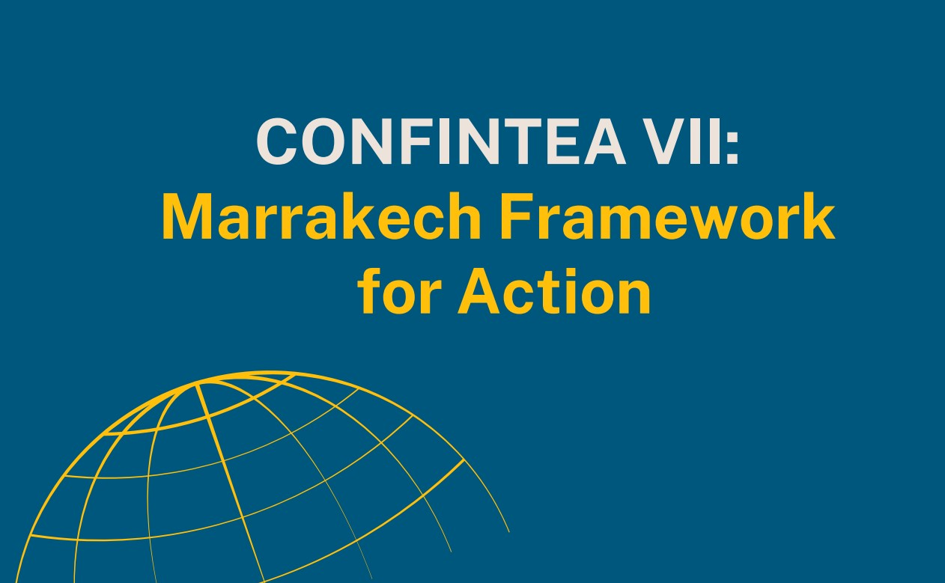
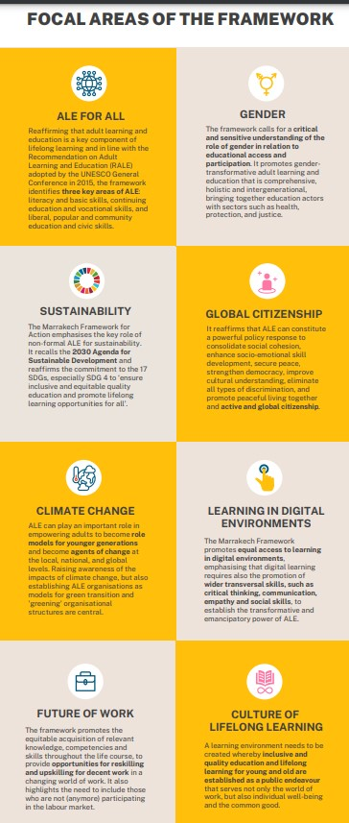
The field of adult education and learning is intriguing, crucial, fragile – and complex
AEL is intriguing – as it is far reaching, covers all educational issues, extends to a large portion of our lives, allows flexibility, can be innovative, even creative, sometimes outside the constraints of a system. Thus, content and pedagogy are relatively free from a constraining tradition.
Crucial as it is expected to support democracy and focus on obvious challenges or concerns of the present such as those presented in the eight focal areas emerging from the Marrakech 2022 conference. It invites personal and social development – enabling people to be a part of a democratic social edifice – to fill into the gaps in a somewhat outdated educational system.
AEL is fragile –more fragile than other parts of education – at least the part of it that is outside the system of education. It has been claimed that it is weak because it is difficult to define and being fragmented – both of which are true – but this goes also for the rest of education – which is incredibly fragmented. I think the fragility of AEL stems mainly from its weak standing within the system – and the uncertainty about its principal justification or rationale.
“In most countries adult education is not recognised as part of the formal education system …. “
2016 UNESCO-UIS/OECD/EUROSTAT (UOE)
https://circabc.europa.eu/sd/a/849a866e-d820-4006-a6af-21cb1c48626b/UOE2016manual_12072016.pdf
.

Slide 5
The field of adult education is
Intriguing, Crucial, Fragile – and Complex
Shaping Futures, Empowering Lives: Lifelong Learning at the Heart of Flourishing for Individuals and Societies
The complexity is mainly due to the many different discursive worlds, as is the case for most comparative educational work. Keep in mind the policy discourse.
These relate to
Different views on what are the principal challenges
Different institutions or platforms
Different levels of the discourse – different worlds – e.g. local, national, regional, global, etc.
Different cultures
Different systems
Different linguistic usages (different terms, different understanding what is being placed in focus)
Different political emphasis – e.g. whom are we talking about
Different economies
Different departures – or foci of the discussion (participation, systems, andragogy, rationale …)
Different backgrounds of the participants in the discussion – different language used (often professional)
Question of responsibilities (individual, industry, state …)
This note on complexity is mainly to emphasise four things:
What, nevertheless, are the uniting parts of the discussion – what is less dependent on these differences? Or, what are the common challenges?
How does the complexity make our discourse more difficult?
Apart from enhancing our understanding of problems seen in a particular situation we may consider how do we see our impact, despite these differences?
To whom are we talking – about our individual concerns – and who is listening?

Slide 6
The future and the present:
How might education deal with the future?
Shaping Futures, Empowering Lives:
Lifelong Learning at the Heart of Flourishing for Individuals and Societies
Education as an institution is notoriously conservative – its organization, its content, and its pedagogy changes very slowly – often it seems to be oblivious to many of the important changes surrounding it.
The important changes are not only confined to technology – perhaps cultural and societal changes are more relevant, and these often seem to call for different emphasis in the approaches adopted in education.
The development of AI is much faster than many people realise, but so are other developments.
Of course, there is some lively discussion going on all over the educational arena deliberating the way education – the system and the idea should attend to the future – see e.g. lively discussion on anticipatory governance.

Slide 7
The future and the present:
How might education deal with the future?
Shaping Futures, Empowering Lives:
Lifelong Learning at the Heart of Flourishing for Individuals and Societies
The basic point I want to make with my following comments is:
The organizational flexibility, the openness and the wide spectrum of content, pedagogy and rationale both implicit and explicit within the fields of adult education, or LLL suggest that it gives a better background to discuss education for the future than what is offered by the mainstream educational debate.
I want to note two important and highly related strands of thought when attending to the future within the field of AEL
The importance of placing the focus on the present – at least no less than on what happens in the future
Considering the basic terminology, it is fruitful to be open to a changes, even when referring to the world of work – move out of the skills arena – to readiness to cope and create.

Slide 8
The future and the present:
How might education deal with the future?
Shaping Futures, Empowering Lives:
Lifelong Learning at the Heart of Flourishing for Individuals and Societies
The normal terminology often refers to skills – basic skills or a variety of different skills – even a category called 21st century skills. In recent decades, the term competences or capabilities are increasingly used, - somewhat broader concepts, but at the same time more contextually enclosed.
In recent years there are number of important developments that are more focussed on the individual’s ability and motivation to act in challenging circumstances, inspired by the salutogenic approach developed by Antonovsky or the importance of being acknowledged and valued as developed inter alia by Honneth.
From salutogenesis we derive the notion of resistance skills, which refer to the ability to cope with novel challenges. We also have the influences of positive psychology and transformative theoretical ideas. From a different direction we have the ideas developed by Fox, using the notion of edGe-ucation which acknowledges that one can usefully go straight to difficult questions, and grapple with them without going through endless basics (tracing the historical steps of the development of knowledge).
Skills
Competencies
General resistance resources (GRRs)

Slide 9
The future and the present:
How education might deal with the future
Shaping Futures, Empowering Lives:
Lifelong Learning at the Heart of Flourishing for Individuals and Societies
I suggest that all these ideas converge to directing attention to the present, where the individual is participating in, and interacting with complex cultures and societies: Thus, emphasising the present, even when preoccupied with preparing for the future. It is not that we don’t know about much that is developing, we a know a lot – but the present still happens to be the most sensible focus.

Slide 10
A variety of discourses
Shaping Futures, Empowering Lives: Lifelong Learning at the Heart of Flourishing for Individuals and Societies
The dimensions of educational discourse are many. We can fruitfully discuss education from anthropological, economic, pedagogical, philosophical, political, psychological, sociological, etc. - perspectives. But many other discourses can be chosen. Here I want to take an institutional perspective and then allude to the policy discourse.
Looking back many centuries, systems of education were gradually developing. For more than one reason the state assumed the buildup of at least parts of it – even if it varied. But an interesting flora of independent organizations were also partly engaged in education: Being in a Nordic conference the folkehöjskolen or the folk high school movement is of particular interest.
During the 20th century the basic system of education gradually solidified. But - a special sturdy system for adults was normally not developed.
Note that in the Icelandic case the system is generally blind to age.

Slide 11
A variety of discourses – the traditional discourse
Shaping Futures, Empowering Lives: Lifelong Learning at the Heart of Flourishing for Individuals and Societies
Education was pre-”life” and pre-work
With the introduction of the LLL discourse around the mid 20th century the rhetorical picture gradually changed.
But in a curious way this did not much affect the system discussion nor the credential discussion which are still operating as before.

Slide 12
A variety of discourses
– the terms being used
»Vi har brug for både uddannelse og dannelse«
Den almindelige dannelse er på vej ud af folkeskolen. Og det er en farlig kurs. Vi risikerer at skabe en nation af ukritiske og manipulerbare borgere, der giver mere plads til totalitære kræfter, siger Michael Böss. (Berlinske tidende 28.8.2020 https://www.berlingske.dk/samfund/vi-har-brug-for-baade-uddannelse-og-dannelse.)
Sometimes it is possible that the terminology we use might be more precise – I will note interesting examples – even though we should not go overboard in insisting on clear definitions. The terms I want to bring up – are lifelong learning, education, needs and evidence.
Education – learning - education
I wanted to move from learning to education
Then I gathered that the trend was the opposite, to move from education to learning!
It all hinges on how one understands – education – as a system (school) or as an idea.
Now I suggest that we should move the discourse from education (the institution) - to learning - and then to education (the humanistic idea)
Thus, I also prefer LLE to LLL
LLL, it is a very transparent concept, but it is still understood in different ways
As the literal expressions points to – learning is not confined to a particular time in life
As the idea that you can have access to some basic education at any time in your life
As the idea that education at an institution can go on for ever.

Slide 13
A variety of discourses – the terms being used
Needs, borrowed from a deficiency discourse
If you don’t have something you will not survive – at least not well
But within the educational domain it might be better to use a different point of departure
The right to something, - or a minimum requirement – which both are general or political statements –
What might be useful or beneficial – who decides that a person would need to learn something (society, industry, the person herself, one's environment).
Both would help to make transparent where the demands come from, e.g. who decides what is needed and to note that very different options might make good sense.
Evidence The crucial role played by evidence in research is obvious to most.
But the social role it plays outside academia is practically always overstated.
Evidence – research does not set benchmarks – these are political decisions
Evidence does not tell you what to do – “evidence-based action” is often a misnomer. But it may certainly alert you that things should be done.

Slide 14
A variety of new discourses: Policy+ discourses
The national, Nordic, European, OECD, outside Europe and then UNESCO+ Global discourses
Shaping Futures, Empowering Lives:
Lifelong Learning at the Heart of Flourishing for Individuals and Societies
Private providers
Europe: individual countries –
among them the Nordic countries
The World Bank
UNESCO
Global discourse
UIL
ICAE
DVV
Global view
Private providers
East
South
West
EU
OECD
European+ policy+ discourse
Enormous cultural differences
EAEA
Europe+
European Council
…
The voice of nonformal adult education in Europe

Slide 15
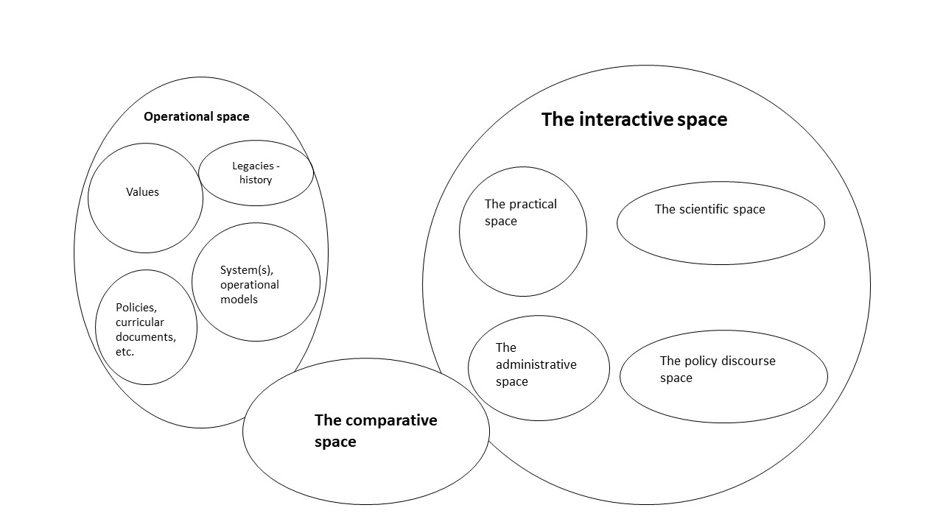
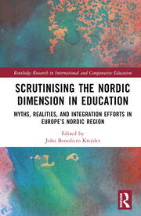
Nordic cooperation
within the field of education
This August:
Chapter 3: “The Nordic interactive and comparative spaces within the arena of education”, Jón Torfi Jónasson and Valgerður S. Bjarnadóttir

Slide 16

The Nordic scene
NVL Nordisk Netværk for Voksnes Læring (NVL) https://nvl.org/english/
It is important to note for a number of reasons – it is supported by state funds (NCM), it fills in institutional gaps, it is a hand-on operation with strong professional support, it organizes – and encourages cooperation between different cultural and administrative regions with full respect for the different languages, it is well connected both locally and internationally, …
Suomi
Finland
Danmark
Ísland
The Nordic+
Norge
Sverige
Nordic folk high schools
Important for several reasons – mention three
They are strong institutions outside the official institution of education. They developed alongside the educational system – and know how to live outside – and what it takes – they are surprisingly resilient activities.
They celebrate and practice an educational outlook that many within the AEL community dream about - perhaps also UNESCO.
They have managed to appeal to many very different groups also in line with a true educational LLL outlook.
The Baltic countries
Points to note
Enormous active and multifaceted co-operation is found among the countries
How little policy coordination is found which means that the approaches – and systems are surprisingly different, despite the very multifaceted and active consultation that has taken place.
How well the rich Nordic countries do on some measures (participation generally) and badly on others (education of immigrants).
How interesting some exemplary projects are – e.g. NVL and the folk-high school activities.

Slide 17
An institutional perspective 1
Shaping Futures, Empowering Lives:
Lifelong Learning at the Heart of Flourishing for Individuals and Societies
Much of education is within an institution – not an organization. And the essential ingredient is culture. This means it is not only governed by rules and formal documents, but much more importantly is governed by cultural values and tradition. Knowledge (sometimes outdated), narrow perspectives and certainly strong vested interests are also very powerful moulding or restraining forces. Acknowledging this is crucial, both for understanding why it is difficult to change many things, but also why it is difficult to transfer practices and policies between cultures – even those which are seemingly similar.
Thus, institutions have weaknesses – but they also have strengths. They carry with them well developed practices, professionalism, sense of purpose, certain fairness according to the rules of the game. Having a transparent framework with a clear sense of purpose, e.g. related to socially recognised aims, is normally also a precondition for social financial support.
The balance between strengths and weaknesses is particularly interesting in the arena of adult education – which often enjoys the creative flexibility of being outside a strong institutional framework – but suffers simultaneously from not having the solid support of a developed institutional frame – and also lack the currency the institution provides.

Slide 18
An institutional perspective 2
Shaping Futures, Empowering Lives:
Lifelong Learning at the Heart of Flourishing for Individuals and Societies
Credentials enter the picture in this connection. This currency of educational participation is – I think - more important (and controlling) than most people realise. One way to think about this is to figure out where would education – e.g. HE, be without the credentials it confers? And we should note how credentials enter the picture in the various discussions about developing adult education outside the school – outside education as institution: when we discuss why and how to move AEL into vocational or HE. The topics of accreditation and VPL come to mind.
This is also a reasonable place to bring in the question of money – in particular, what is the state prepared to pay for and how is that discussion tied to the credential issue. When I have participated in the discussion about developing high minded ideas about adult education – I keep asking – who is prepared to pay and on what basis. The question of money – who pays – and on what basis – is always – always - the crucial one?

Slide 19
An institutional perspective 3
Shaping Futures, Empowering Lives:
Lifelong Learning at the Heart of Flourishing for Individuals and Societies
As a way to reflect on these issues I bring in two totally different areans which I find particularly important:
The development of Validation of Prior Learning – VPL. Perhaps the most important and interesting recent development within the field of adult learning. But it raises several questions. Could it have been developed inside the system of education? Conversely, does it need an institutional structure to get off the ground? Is it mainly a way to connect to the institution of education? Where does it end up. - Then we continue: What kind of institutional existence best serves the development of adult education? Are there other developments that beg the same questions?
The other arena is that of the Nordic high school movement. It has flourished for a long time outside the state-run education system. It has kept its state support, it has eschewed the credential control and manged to develop and apparently retain its educational character. Perhaps we can learn from the resilience of this movement to structure the institution(s) of adult education – and have the best of both worlds, strength and flexibility?

Slide 20
An institutional perspective 4
Shaping Futures, Empowering Lives:
Lifelong Learning at the Heart of Flourishing for Individuals and Societies
So, what do we wish for, from the institutional perspective:
To move the part of adult education that is most pressing into the current system of education – i.e., the system that often marginalised some of the people we are often talking about? Note that the system is strong, well developed – and has the currency that has value within our societies??
Or to establish a separate institutional framework – or even frameworks - for the tasks that many of us think should be undertaken??
Or should we refrain from any institutional frame – perhaps somewhat on the lines Ivan Illich talked about?
I think it is important to learn the views of the various stands of the ALE academic community on the institutional issue.

Slide 21
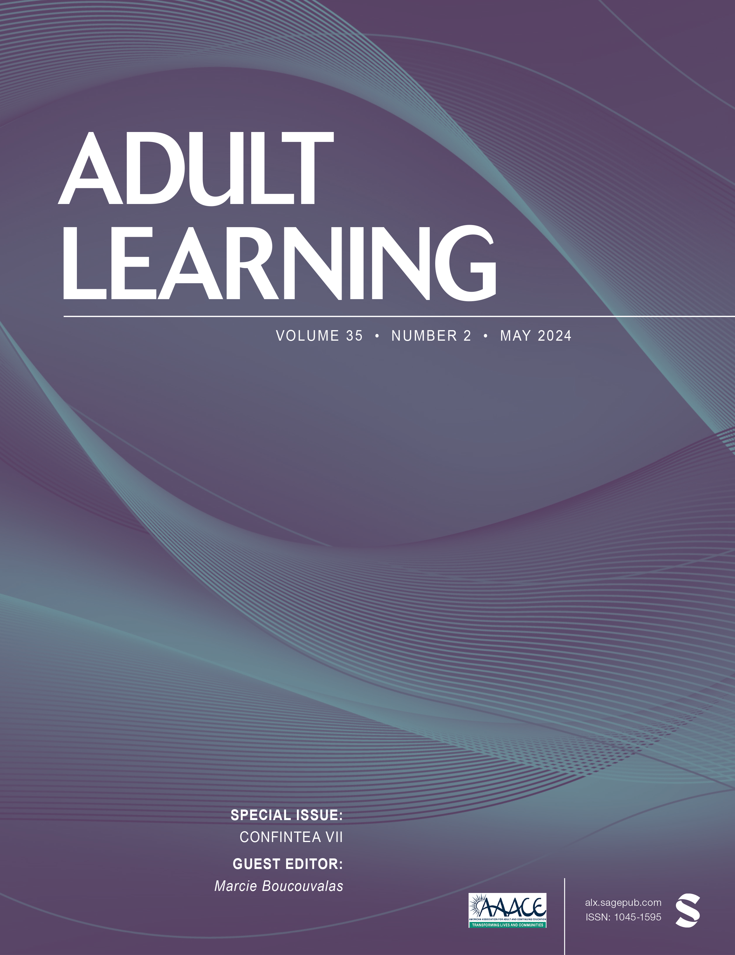
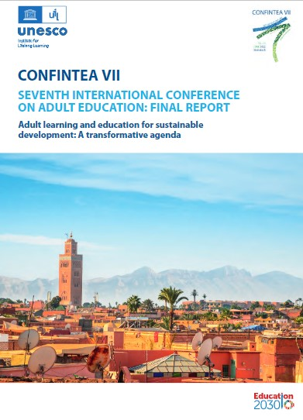
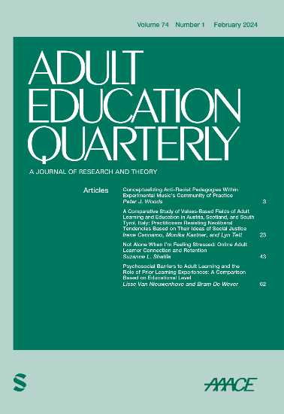
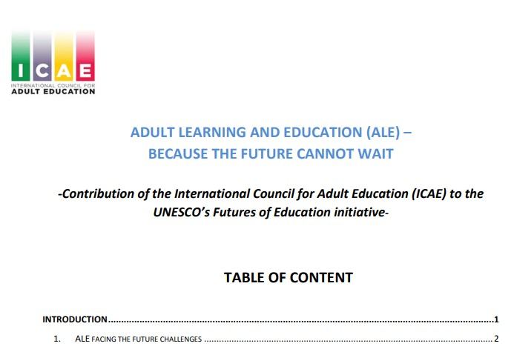

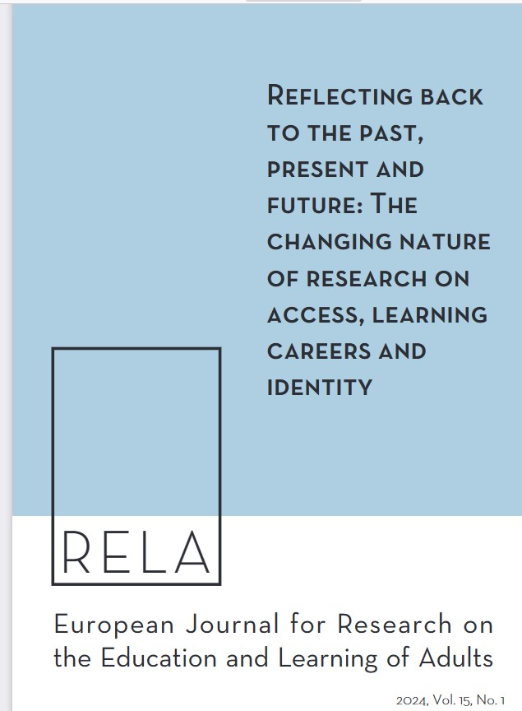
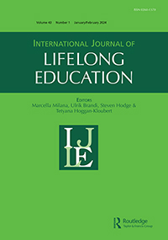
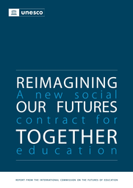
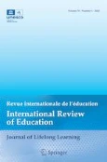
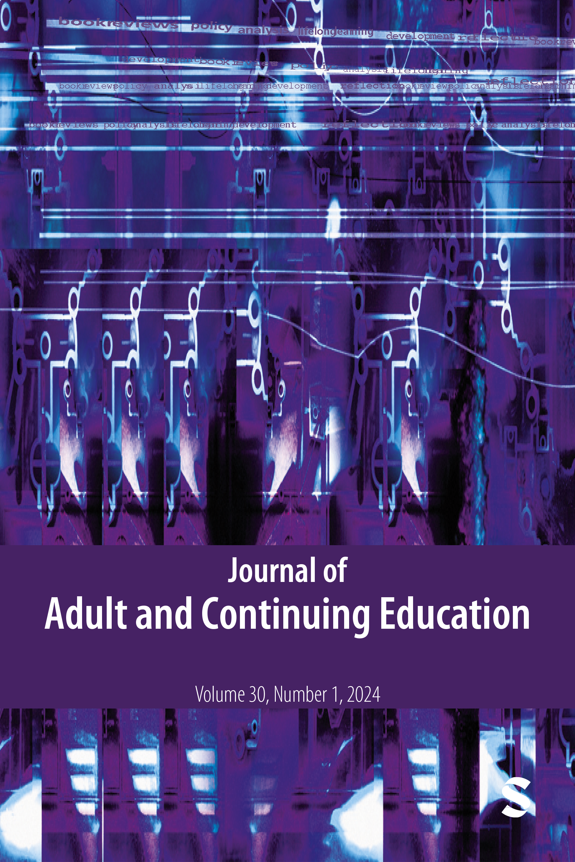
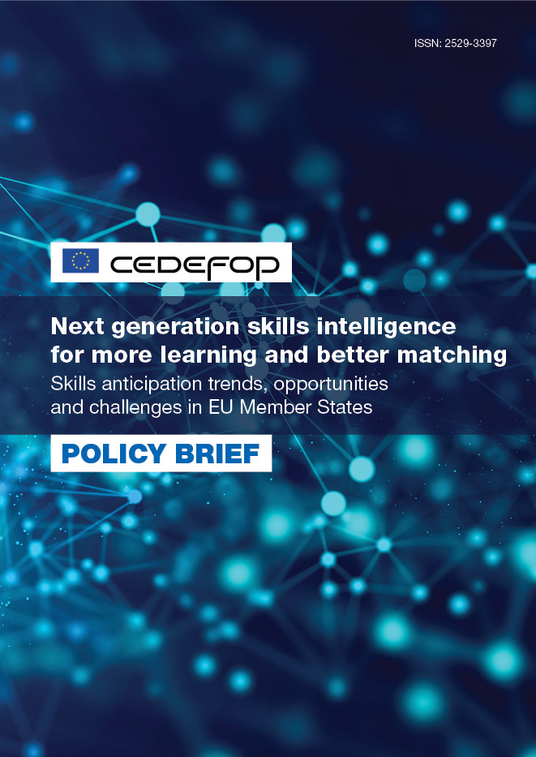

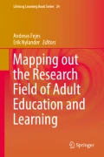
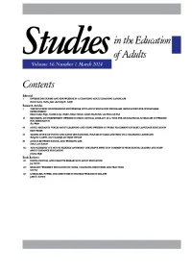

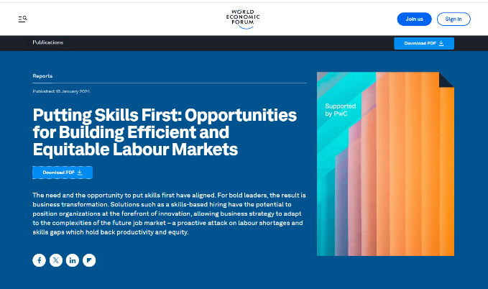
The role of academia
How do we talk - connect?
Shaping Futures, Empowering Lives:
Lifelong Learning at the Heart of Flourishing for Individuals and Societies
Special issue: CONFINTEA VII (May 2024)
https://journals.sagepub.com/toc/alxa/35/2
Adult Education Quarterly - Volume 74, Number 1, Feb 01, 2024 (sagepub.com)
Around the world in fifteen articles
World Economic forum

Slide 22
The role of academia: How do we talk - connect?
Shaping Futures, Empowering Lives:
Lifelong Learning at the Heart of Flourishing for Individuals and Societies
We are, once again, starting an academic conference – it is always delightful and empowering. We meet new ideas, new approaches, literally new worlds – and we meet colleagues who share our interest.
Education –including of course adult education both demands, and benefits from, enlightened and scientific discourse. It helps us to understand phenomena, to see what is happening and what might be done differently and were action makes sense or is even crucial. This of course holds for adult education as all other arenas of education, the social sciences or any other field. That is why we run adult education departments at universities, hold academic conferences on the topic and publish academic adult education journals.
Evidence – understanding, motivate all research. And these energize further probing, further research which hopefully give rise to new ideas. But there is a problem. Neither tell us what to do, even if they certainly can suggest options – often many. They suggest where action is relevant – where it makes sense or even is crucial and may certainly inspire action. But selecting the most promising action track is much more problematic.

Slide 23
The role of academia: How do we talk - connect?
Shaping Futures, Empowering Lives:
Lifelong Learning at the Heart of Flourishing for Individuals and Societies
The notion of evidence-based action, i.e. that once you have got the evidence, you know what to do is based on problematic thinking.
This rather complex aspect of the complex research –practice, or -policy nexus should stimulate us to discuss – at least occasionally –how our endeavours could connect to the world outside academia. And we should discuss this at our academic conferences. There is no other (or better) place.
Of course, we see all kinds of very sensible structures set up related to various fields of science which all has the same issues: Mode 2 university departments, science parks or incubation centres or hubs, and triple (or quadruple and quintuple) helixes are promising. The ideas clearinghouses, of translational science or knowledge may be fruitfully used within various fields. But the fact that these are set-up acknowledge the complexity of the situation. And of course, a lot of research is constantly being applied – but it is not applicable as it stands.

Slide 24
The role of academia: How do we talk - connect?
Shaping Futures, Empowering Lives:
Lifelong Learning at the Heart of Flourishing for Individuals and Societies
It would be unfair to suggest that somebody else is better suited to deliberate and harness what we discuss. It is us that are immersed in the projects we cherish. Some of us are paid for extensive researching and teaching – we sometimes spend months or years – and often more years – collecting data, reading about related developments, mastering the concepts and vocabulary of the field; we have an insight and mastery that nobody else has. We know well the strengths – but also the weaknesses of our work. And the situation is normally not simple.
There may be scores of our colleagues doing related research in different contexts and the meta-research or meta-meta-research shows that a picture from a single study is rarely reflected in all the other studies. And we realise this. Hardly anybody outside our academic circles has anything like our understanding of the possible nuances and the potential relevance of our work.
So of course, we should shoulder a substantial responsibility for discussing the possible implications of our research. We are those who best understand our data, the context and the challenges that it faces. But suggesting and determining action, whether in practice or policy require creativity and boldness but also political sense and certain realism. I feel an effort of this type is generally lacking among the social sciences – even if we find interesting and welcome examples.

Slide 25
The role of academia
How do we talk - connect?
Shaping Futures, Empowering Lives:
Lifelong Learning at the Heart of Flourishing for Individuals and Societies
Special issue: CONFINTEA VII (May 2024)
https://journals.sagepub.com/toc/alxa/35/2
Adult Education Quarterly - Volume 74, Number 1, Feb 01, 2024 (sagepub.com)
Around the world in fifteen articles
World Economic forum

Slide 26
The role of academia: How do we talk - connect?
Shaping Futures, Empowering Lives:
Lifelong Learning at the Heart of Flourishing for Individuals and Societies
We are, once again, starting an academic conference – it is always delightful and empowering. We meet new ideas, new approaches, literally new worlds – and we meet colleagues who share our interest.
Education –including of course adult education both demands, and benefits from, enlightened and scientific discourse. It helps us to understand phenomena, to see what is happening and what might be done differently and were action makes sense or is even crucial. This of course holds for adult education as all other arenas of education, the social sciences or any other field. That is why we run adult education departments at universities, hold academic conferences on the topic and publish academic adult education journals.
Evidence – understanding, motivate all research. And these energize further probing, further research which hopefully give rise to new ideas. But there is a problem. Neither tell us what to do, even if they certainly can suggest options – often many. They suggest where action is relevant – where it makes sense or even is crucial and may certainly inspire action. But selecting the most promising action track is much more problematic.

Slide 27
The role of academia: How do we talk - connect?
Shaping Futures, Empowering Lives:
Lifelong Learning at the Heart of Flourishing for Individuals and Societies
The notion of evidence-based action, i.e. that once you have got the evidence, you know what to do is based on problematic thinking.
This rather complex aspect of the complex research –practice, or -policy nexus should stimulate us to discuss – at least occasionally –how our endeavours could connect to the world outside academia. And we should discuss this at our academic conferences. There is no other (or better) place.
Of course, we see all kinds of very sensible structures set up related to various fields of science which all has the same issues: Mode 2 university departments, science parks or incubation centres or hubs, and triple (or quadruple and quintuple) helixes are promising. The ideas clearinghouses, of translational science or knowledge may be fruitfully used within various fields. But the fact that these are set-up acknowledge the complexity of the situation. And of course, a lot of research is constantly being applied – but it is not applicable as it stands.

Slide 28
The role of academia: How do we talk - connect?
Shaping Futures, Empowering Lives:
Lifelong Learning at the Heart of Flourishing for Individuals and Societies
It would be unfair to suggest that somebody else is better suited to deliberate and harness what we discuss. It is us that are immersed in the projects we cherish. Some of us are paid for extensive researching and teaching – we sometimes spend months or years – and often more years – collecting data, reading about related developments, mastering the concepts and vocabulary of the field; we have an insight and mastery that nobody else has. We know well the strengths – but also the weaknesses of our work. And the situation is normally not simple.
There may be scores of our colleagues doing related research in different contexts and the meta-research or meta-meta-research shows that a picture from a single study is rarely reflected in all the other studies. And we realise this. Hardly anybody outside our academic circles has anything like our understanding of the possible nuances and the potential relevance of our work.
So of course, we should shoulder a substantial responsibility for discussing the possible implications of our research. We are those who best understand our data, the context and the challenges that it faces. But suggesting and determining action, whether in practice or policy require creativity and boldness but also political sense and certain realism. I feel an effort of this type is generally lacking among the social sciences – even if we find interesting and welcome examples.

Slide 29
Shaping futures: How is it done?
Who and what is shaping our futures? We have an important role to play in the field of adult education and learning. What can we contribute and how?
And what might be useful to note or understand for us to contribute to the enlightened shaping of our futures? I suggest:
Being informed – enlightened and even critical of our own discourse.
Being aware of the ethical or rather the political character of enlightenment.
Being very conscious of the nature and extent of communicating what we know and believe in. Acknowledge our role – duty? to communicate – and not only among ourselves.
Understanding the nature of societal change – there are so many things holding back, but hardly any of those are negative or malignant – they are just a part of the nature of human society – and some of them we want to cherish and retain.
Nurture and clarify our ideals no less than our ideas, and foster enthusiasm for empowering lives – to allow these to flourish.
Shaping Futures, Empowering Lives:
Lifelong Learning at the Heart of Flourishing for Individuals and Societies

Slide 30




The world of adult education and learning is certainly intriguing, crucial, and complex – perhaps fragile at times
Thank you – kærar þakkir

