Slide 1
Jón Torfi Jónasson, professor emeritus
School of Education, University of Iceland
jtj@hi.is
http://uni.hi.is/jtj/en/
16th Nordic Conference held by NORDYRK
Et nordisk forskernetværk om erhvervspædagogik og erhvervsdidaktik
Evolving VET: Navigating traditions and transformations
Evolution or transformations in VET?
What might evolve? What might transform? And which are the controlling forces?
Jón Torfi Jónasson
June 3rd 2024

Slide 2
Preamble – it is about education and communication
In 1905 a new law on farmers education was passed in Iceland. Inspired by the Danish and Norwegian folk high school movement the law on farming colleges, - education for farming – was changed to a law on colleges for educating farmers.
(The idea of education plays a major role)
In 2016, after decades of debate, upper secondary academic education, was changed from 4 to 3 years on the basis that three years was sufficient to prepare for university.
(It all centres around the institutional side of education – education as an idea is absent.)
Would this be symptomatic of the development of the discourse on education during this time?
Current issues:
Attention to the basic terminology we use
How we think about the connection between education and the future
How we connect and communicate – or don’t - in our professional discourses, but most importantly to and with those outside our professional world. I place this discussion in the perspective of fragmented discourses
Understanding of how things change – or do not change – what impedes change
How we think about evidence and how it may be harnessed

Slide 3
Arenas for discussion – Language - terminology
Part 1
An example: the term Education
I wanted to move from learning to education (the latter being more open – i.e., the idea of education),
But I was informed that most people want the opposite (as they were talking about the institution of education), i.e., they wanted to move from education to learning
Here the Nordic languages have the subtleties English does not have as the discourse is normally conducted:
Scandinavian/Nordic languages have important nuances
Education as referring to the system
(Utdannelse – utdannelse/utdanning – utbildning – koulutus – menntun)
Education as an idea –
(Dannelse – dannelse/danning – bildning – learning – sivistys – menntun)
Thus, I would now phrase my thought:
Education (school) – learning – education (idea)
(Thus, we should talk about language)
Terms that should be discussed- we should spend much more time discussing the thoroughly :
Education
LLL – AEL –Continuing education - …
Skills and competence – moving on to permaskills and skills intelligence
Needs (perhaps the scoundrel in the current educational discourse)
Evidence – evidence-based action
Degrees, credentials, qualifications, …
Culture, tradition, vested interests, … (the chief controllers of no change )
…
(The green terms reappear in the following presentation.)

Slide 4
The future and the present:
How might education deal with the future?
Part 2
Evolving VET: Navigating traditions and transformations
I have been very interested in how we talk about education and the future for a long time. The connection between the two is not simple.
I have complained about the lack of proper focus on this issue in the educational discourse during the last decades.
(Recently I have substantially changed my argument as will transpire).
Points I have tried to make in the past:
Much is known about what is developing (don’t pretend we don’t know a lot – even if there is much we don’t know)
But most of us know only a tiny portion of these developments (which may be our excuse – and perhaps it is best to be ignorant about some things)
Of course, education should be relevant – also tomorrow – but how?
There are more changes than those related to technology (we should talk about all of them)
The most important changes should relate to the ingredients of education, -- not method, form or frameworks – thus the notion of education becomes crucial – as the main point of departure.
How we talk about the future.

Slide 5
The future and the present:
How might education deal with the future?
Evolving VET: Navigating traditions and transformations
Thus, I want to re-emphasise two important and highly related strands of thought when attending to the future within the field of VET
The importance of placing the focus on the present – at least no less than on what happens in the future (this the most important change in my views)
The normal terminology often refers to skills – basic skills or a variety of different skills – even a category called 21st century skills. But competences are increasingly used, and I will note that different concepts and very different perspectives are being introduced that may challenge the usefulness of the emphasis on skills. But the problem with skills – and even competences- is the way these concepts tend sift out the notion of education – they are in that sense non-educational (at least tend to be- and the proponents would probably not see it that way).

Slide 6
The future and the present:
How might education deal with the future?
Evolving VET: Navigating traditions and transformations
In recent years there have been a number of important developments that are more focussed on the individual’s ability and motivation to act in challenging circumstances, inspired e.g., by the salutogenic approach developed by Antonovsky from whom we derive the notion of resistance resources, which refer to the ability to cope with novel challenges. We also note the importance of being acknowledged and valued as developed inter alia by Honneth. We also have the influences of positive psychology and transformative and also capability theoretical ideas. Each of these terms refers to grand theoretical frameworks, each of which – but in different ways – emphasise the ability to cope, flourish – now and later.
From a different direction we have the ideas developed by Fox, using the notion of edGe-ucation which acknowledges that one can usefully go straight to difficult questions, and grapple with them and gain sophisticated understanding without going through endless basics (tracing the historical steps of the development of knowledge). This allows powerful curriculum to be in focus at all levels of education.
All of these shift the focus somewhat to the idea of education: to understanding, to the capability to function well, coping with novel circumstance and challenges. These ideas are optimistic, relevant and demand that education once again becomes the centre of education.
Skills
Competencies
General resistance resources (GRRs)
Capabilities
Published June 2024

Slide 7
The future and the present:
How education might deal with the future
Evolving VET: Navigating traditions and transformations
I suggest that all these ideas converge to directing attention to the present, where the individual is participating in, and learning to interact with complex cultures and societies – with complex new challenges:
Thus, we emphasise the present, even when preoccupied with preparing for the future.
It is not that we don’t know much about what is developing, we a know a lot – but the present still happens to be the most sensible focus.
If there is a visible – even gradual shift in emphasis from skills, to competence, to resources or capabilities, … in the theoretical discourse – what about the other discourses, outside academia – are they moving in the same direction?
Keep this question in mind when I draw attention to apparent fragmentation of discourses.

Slide 8
– Fragmentation and communication
Part 3
Fragmentation of discourses.
Communication within and between the different discourses is often lacking.
There is (undue) optimism about who listens and how ideas travel.
I mention two sides to this fragmentation
One is that there exist such a multitude of discourses, most of which are within their own bubbles – and simply not reaching other discourses.
Second, is that even though the terms used are the same or similar, what they refer to and thus how they are understood is often totally different. The apparent communication is not working. But it seems that we are often oblivious to this.
Here I present an attempt to indicate this fragmentation – by noting several discourses and simultaneously I give an impression of the extent and seriousness of apparent fragmentation – it is not an attempt to map the situation.
I also continuously wonder how the different discourses interact.

Slide 9
– The various discourses / worlds
1. How much interaction is there between the spheres?
Three main questions
VET- institution – the idea
C
B
A
Students, teachers, mentors
Policy impact
C
B
A
Within each sphere there are many!
Academia
This is not a map! Just an impression.
Policy makers
C
B
A
Industry
International discourse
C
B
A
2. How much interaction is there within the spheres?
C
B
A
3. How actively and effectively does academia communicate its work to the other spheres?

Slide 10
– VET –the idea and the system
VET or TVET
Is both an institution and an idea
VET- institution – the idea
To treat vocational education as a homogenous object of inquiry seems sometimes to call for justification (which is normally absent).
C
B
A
Differences between systems relate to (and tend to unduly ignored)
Different views on what are the principal challenges
Different cultures
Different systems
Different linguistic usages (different terms, different understanding what is being placed in focus)
Different political emphasis
Different economies
Question of responsibilities (individual, industry, state …)
There are deep-rooted characteristics of both the institution and the idea, and these vary between cultures
The cultures in which these are rooted are both strong and different
Some parts of these systems have incredibly deep roots.
The systems adopted are surprisingly different – even in the closely connected Nordic countries, even when the underlying ideas are similar
The system and content varies according to school level (which somewhere is gender related) – vocational education is now increasingly at both upper secondary and tertiary levels
The challenges faced are very dependent on the occupational field, which is too often ignored
The research bases varies substantially between fields – in some fields there is a strong research base – in others very weak

Slide 11
– The international discourse
The international soft policy discourse is substantive and quite rich and varied – but perhaps less so than we might expect: UNESCO, World Bank, OECD, EU, CEDEFOP, NVL ….
International discourse
C
B
A

Slide 12
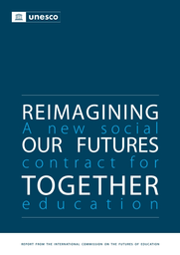
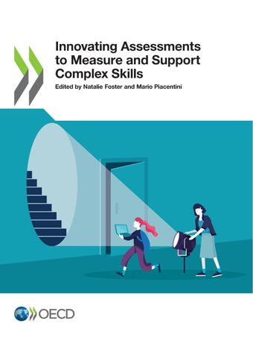

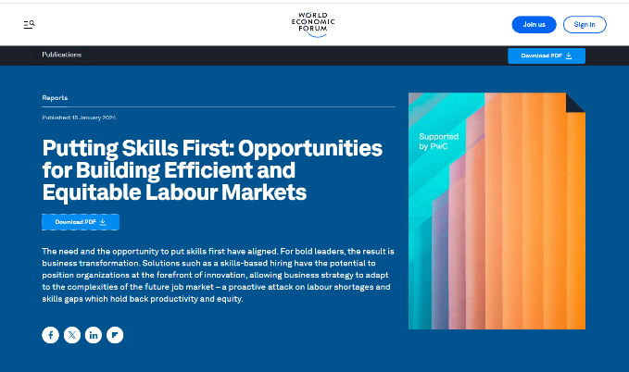
The role of global influencers
World Economic forum
2023 e5f3e341-en.pdf (oecd-ilibrary.org)
The emphasis in the international discourse?
UNESCO, World bank, OECD, EU, ….
Education – skills – competence - …. There are variations – but less than might be expected

Slide 13
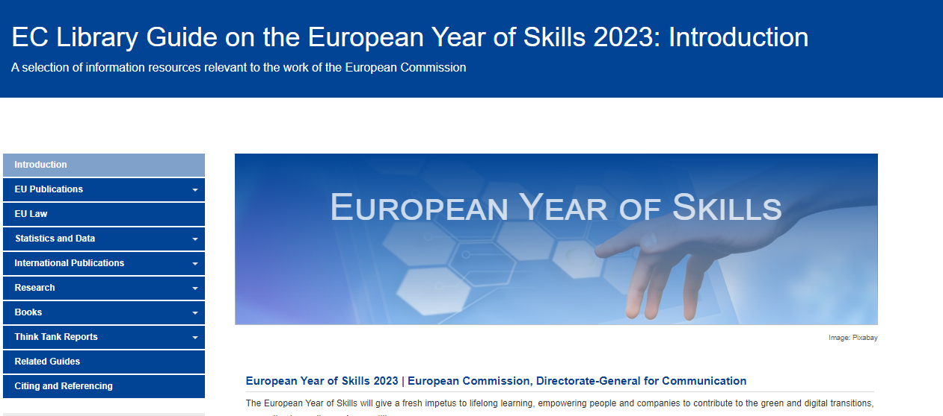
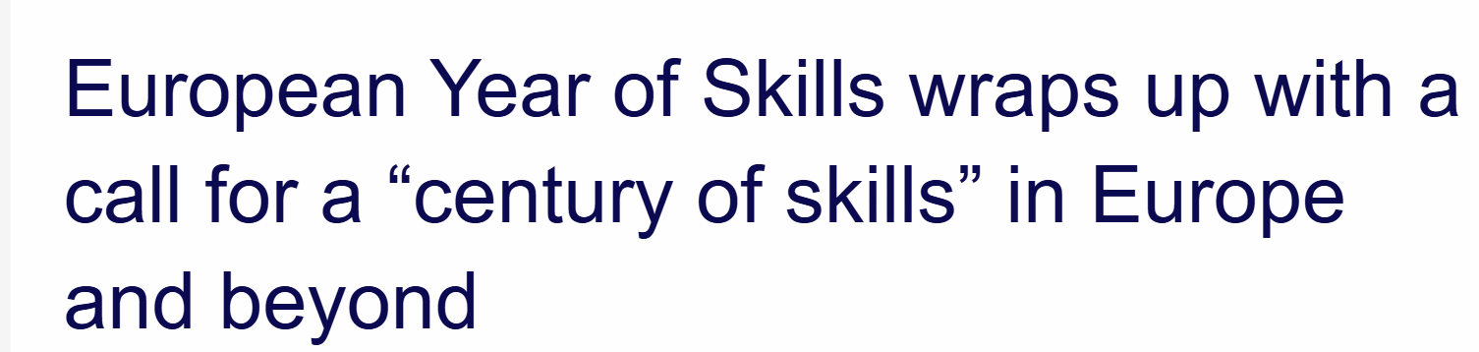
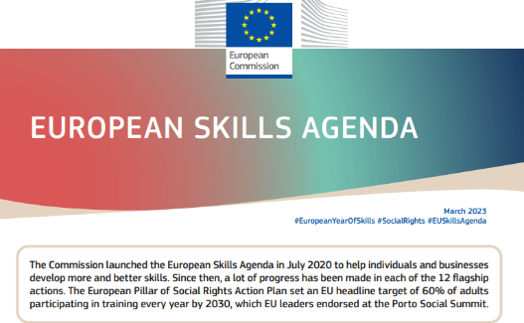
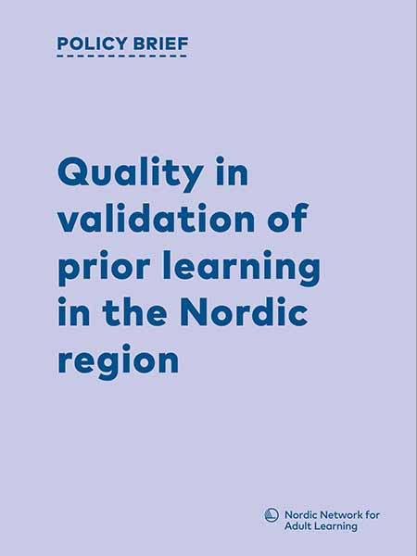
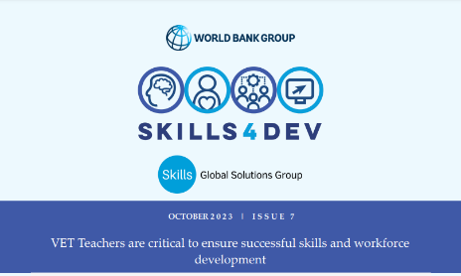
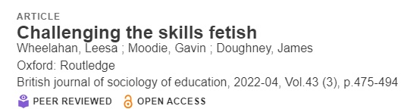
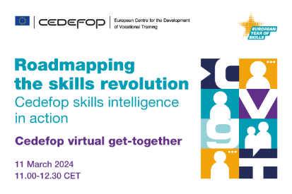
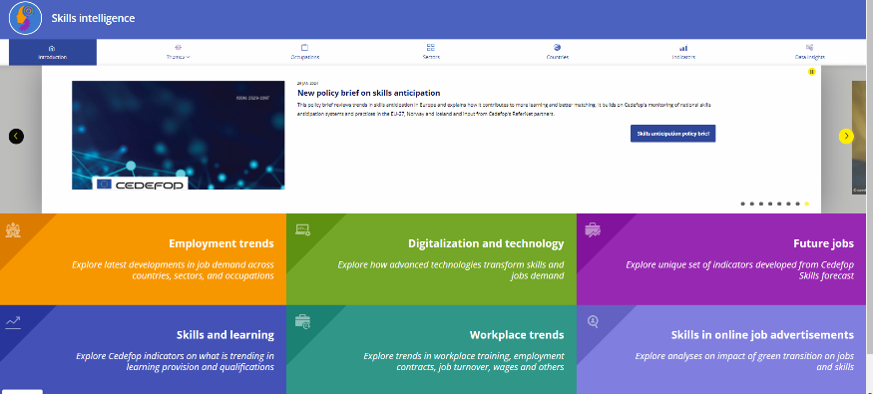
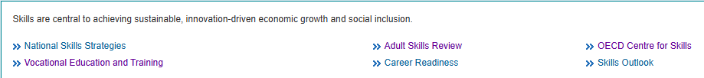
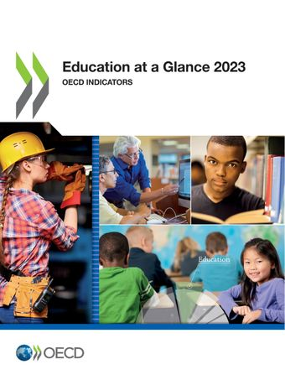
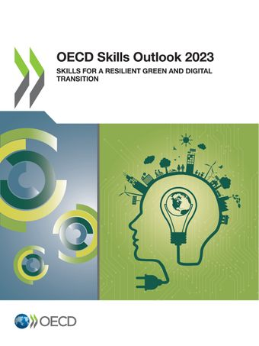
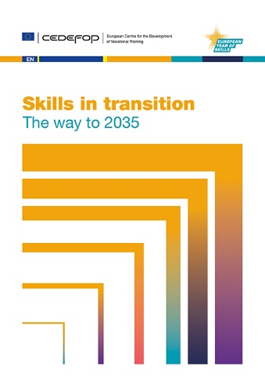
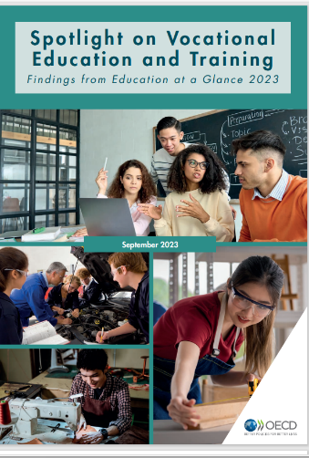
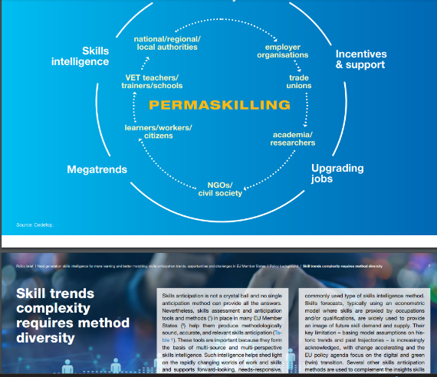
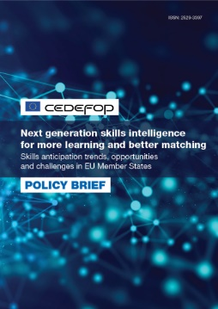
Arenas for discussion – Observations and challenges that inspire my comments and concerns.
The international soft policy discourse is substantive and quite rich: UNESCO, World Bank, OECD, EU, CEDEFOP, NVL ….
UNESCO Transforming technical and vocational education and training for successful and just transitions: UNESCO strategy 2022-2029
NVL: Vocational education and training of the present – a joint Nordic initiative 2023-25
World bank
EU 2023 Year of skills (Closing 30.4.2024)
OECD
International discourse
C
B
A
CEDEFOP

Slide 14
– The research community
Large number of journals, conferences – and an active research community:
Scopus gives ̴1200 titles per year using “vocational education”. (But somewhat complicated to define)
Interaction within the community seems to be lively with journals and conferences.
Academia is surprisingly fragmented but probably interacts more than any of the other discourse spheres.
Academia
Dimensions of fragmentation – and these are really important.
Background participants :
Have different foci – areas of interest
Come from different vocational fields
Come from different academic fields
Have very different roots in the VET+ system
C
B
A

Slide 15
– The VET system and the idea
Number of people involved? In Europe?
VET- institution – the idea
C
B
A
Students, teachers,
mentors
C
B
A
Dimensions of discourse fragmentation: countries, level within the system, occupations, background of people, …
Thinking about development:
What affects the content and form of these arenas?
How effective is this influence? And how timely?

Slide 16
– Industry – the world of work
Does industry listen to any of the other circles? Should it?
What are the explicit interests of industry? WoW.
What are the implicit interests of industry?
How influential is industry in the development of VET – and through what mechanism?
How diverse is industry?
In terms of composition
In terms of developments
In terms capacity
Society and the large context of all aspects of the world of work - WoW
Industry
C
B
A

Slide 17
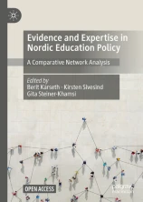

– The policy discourse
Does policy have an impact:
What counts as change?
What can be changed?
What cannot be changed?
What should be changed?
What shouldn’t be changed?
Policy impact
Policy makers
Who are the formal policy makers?
Who are the effective policy makers?
What are the ideas that change policy?
What are the vested interest that push for change? Or - no change?
Our principal question:
To what extent does academia play a role?

Slide 18
- The research community
How do these discourses interact?
What is the role played by academia in potential interactions?
We must deliberate this.
Academia
C
B
A

Slide 19
– The various discourses
How do these discourses interact?
VET- institution – the idea
C
B
A
Students, teachers, mentors
Policy impact??
C
B
A
What is the role played by academia in potential interactions?
We must deliberate this.
Academia
Policy makers
C
B
A
Industry
International discourse
C
B
A
C
B
A

Slide 20
– The various discourses
How do these discourses interact?
VET- institution – the idea
C
B
A
Students, teachers, mentors
Policy impact??
C
B
A
What is the role played by academia in potential interactions?
We must deliberate this.
Academia
Policy makers
C
B
A
Industry
International discourse
C
B
A
C
B
A

Slide 21
Evolution – transformation –?
Part 3
Evolving VET: Navigating traditions and transformations
Paper in JVET 74(1) 2022 see pp 84-85 https://www.tandfonline.com/doi/epdf/10.1080/13636820.2020.1833078?needAccess=true
Does the vocational curriculum have a future?
Michael Young: “My prediction is that the vocational curriculum in its present form will disappear.”
Jim Hordern: “There is good reason to suggest that the vocational curriculum will not disappear, … “
It is of course worth speculating what it means if a curriculum – disappears – what present form means – but the discussion between these two academics is important both at the deep and the superficial levels.
And we can also turn it into the more general question: where is VET heading – within each of our cultures? Is it evolving – transforming – or disappearing??
40 years ago, I was asked to predict educational development for the next 25 years. I was asked because I was considered likely to delineate the enormous changes that people knew would take place. I knew a fair bit about the use of computers in education – and would perhaps be able to explain why schools might perhaps no longer exist. But, I predicted little change; very mundane and boring reading. But I was largely right.
Since, - my speculation about how education would – and should develop, has been among my main interests:
Change - of – and within - the system of education: When do we see stagnation – stability - evolution – transformation?
What changes, and what doesn’t?
One should look both at the inside of the educational edifice and outside it.
What drives changes and what holds them back?

Slide 22
Part 3
Evolution - transformation
Evolving VET: Navigating traditions and transformations
Inside institutional education
Credentials – curriculum – pedagogy change very slowly – largely because they are institutions in themselves – not organizations
There are developments: Institutions drift toward homogeneity and higher status and there is a gradual academic drift.
What characterises these institutions and accounts for slow development?
The most important factors are culture (e.g., traditions), curriculum and the fragile connection to the world of work? Perhaps also vested interests within the system?
How does the interaction between these worlds develop?
Do they open up to each other – as the intention is? Do they connect better?
Or do they close in onto themselves? Does the increased professionalisation (at the educational side), and specialisation (at the industrial side) at least partly, induce isolation? How does the education system follow the changes in the world of work?
The academic sphere -- us?
How do we develop? Go deeper – connect better? Do we recognise our inert culture?
Outside institutional education: the world of work
Multifaceted substantial changes: There are simultaneously rapid changes or transformations in the social culture, norms and structure, social composition, modus operandi of the world of work, - there are visible grand challenges, and most aspects of technology are transformed.

Slide 23
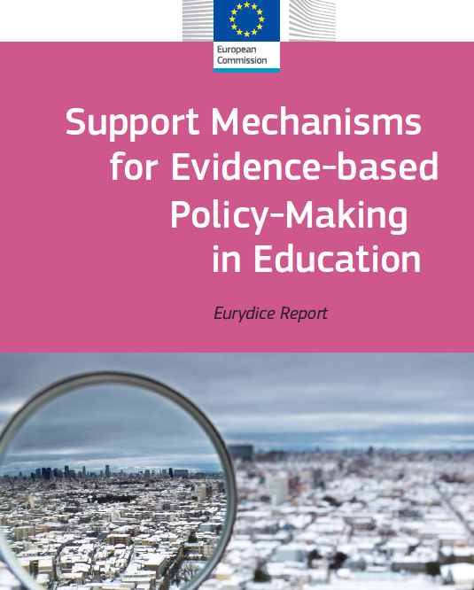
The role of academia: How do we talk - connect?
Part 4
Let us turn to ourselves:
Our raison d'être in academia is that it is the hallmark of modern culture to be informed, enlightened and our research activity is our contribution. We also believe that understanding and evidence is the precondition for sensible action.
We labour to develop our ideas, meet and write to refine them and disseminate them. On the whole we do this quite well. They will thus be a basis for further developments. Science for the sake of science.
And many of us also assume that these ideas will be used outside our confines, present understanding that guides both policy and practice. But there are two substantial problems.
The lesser one is that our ideas are rarely clear-cut and easily understandable outside our circles. And there are preciously few who have the interest or competence (or time) to take them up.
But the major one is that there is very little either explicit or implicit in our research that informs about action – except to suggest that action is appropriate. I think this refers to most serious misapprehension of the research community. (And the reference here is to good, solid, sophisticated research.)

Slide 24
The role of academia: How do we talk - connect?
Evolving VET: Navigating traditions and transformations
The notion of evidence-based action, i.e., that once you have got the evidence, you know exactly what to do, is based on problematic thinking – to be polite.
This rather complex aspect of the complex research –practice, or -policy nexus should stimulate us to discuss – at least occasionally –how our endeavours could connect to the world outside academia. And we should discuss this at our academic conferences. There is no other (or better) forum.
Of course, we see all kinds of very sensible structures set up related to various fields of science which all have the same issues. These apply in different ways to our concerns: There are science parks or acceleration or incubation centres or hubs. Clearinghouses, or the ideas of translational science or knowledge may be fruitfully used within various fields. When attending to long-range issues we have mode 2 university departments, and then triple (or quadruple and quintuple) helixes may perhaps be more relevant. We should discuss what is most relevant for the various corners of vocational education.
The fact that these various platforms or operational spaces are set up acknowledge the complexity of harnessing research. And of course, a lot of research is constantly being applied – but it is not applicable as it stands. Here I am referring simultaneously to various types of research and mountains of data – assuming all to tolerate critical scrutiny. (And CRT research is of no help here.)

Slide 25
The role of academia: How do we talk - connect?
Evolving VET: Navigating traditions and transformations
Risking to be arrogant I claim that it would be unfair to suggest that somebody else – i.e., those outside academia, is better suited to deliberate with overview and critical understanding - and then harness, what we provide. It is us that are immersed in the projects we cherish. Some of us are paid for extensive researching and teaching – we sometimes spend months or years – and often more years – collecting data, reading about related developments, mastering the concepts and vocabulary of the field; we have an insight and mastery that nobody else has. We know well the strengths – but also the weaknesses of our work. And the situation is normally not simple.
Of course we are not alone in our research endeavours. There may be scores of our colleagues doing related research in different contexts and the meta-research or meta-meta-research shows that a picture from a single study is rarely reflected in all the other studies. And we realise this. Very few outside our academic circles have anything like our understanding of the possible nuances and the potential relevance of our work.
So of course, we should shoulder a substantial responsibility for discussing the possible implications of our research. And take time to do it – on top of our necessary and fruitful normal conference discussions and interactions through journals. We are those who best understand our data, the context and the challenges that it faces. But suggesting and determining action, whether in practice or policy require sophistication, creativity and boldness but also political sense and thorough understanding of the vested interests and institutional straight-jackets that limit the scope for action. I feel an effort of this type is generally lacking among the social sciences – even if we find interesting and welcome examples.

Slide 26
Evolving VET: Navigating traditions and transformations
Conclusion
I am convinced that a conference of this type is important, probably crucial as a platform to develop and communicate ideas – to gain both depth and width. And to engage in a critical discourse as a method to both evolve and transform ideas.
But in the process, we should also be:
Informed – enlightened and even critical of our own discourse. Thus, all the hallmarks of education should characterise our endeavours.
Aware of the ethical or rather the political character of enlightenment. To decide where and when to act and how to choose between possible actions is a political more than a scientific decision. But is inseparable from our professional duty as academics to initiate and engage in that discussion.
Discussing the curricular content of VET which to me is most important area for the field. We should, among other things discuss what makes VET educational – and thus important.
Probing the nature of societal change – there are so many things holding back, but hardly any of those are negative or malignant – they are just a part of the nature of human society – and some of what we have, we want to cherish and retain.
Be conscious of the importance of communicating what we know and believe in. Acknowledge our role – duty? to communicate – and not only among ourselves. And we should discuss this. I am convinced that a lack of communication to the outside of our safe space really impedes important developments. We are probably not contributing what we have to offer.

Slide 27


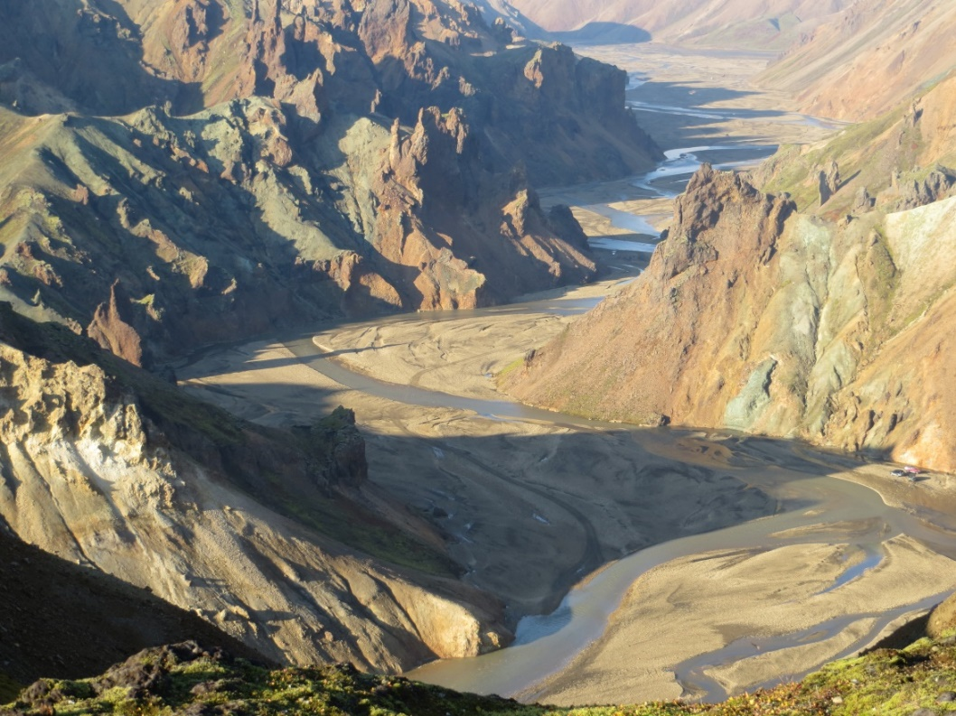

The worlds of VET are immense and important, but we may speculate if they receive the academic attention they deserve and deliberate what academia can contribute to the discourses that mould its evolution – or transformation?
I wish you a good conference
Thank you – kærar þakkir

